Slide 1

E-Learning Platform Management
Team Members :
Bollineni Narasimha Naidu
Thammineni Vamsi Krishna
Sura Venkata Subbarayudu
Kuncham Venkat Ramana Reddy

Slide 2

ABSTRACT
E-Learning Platform using Django and Python is a comprehensive web application designed to facilitate online education and provide a robust learning environment for students and educators. Built on Django's powerful framework, the platform offers a wide range of features to support interactive learning, course management, and student engagement. The application enables educators to create and manage courses, upload learning materials, and design interactive assignments and quizzes. Students can access course content, participate in discussions, and track their progress through a user-friendly interface. Django's backend handles user authentication, data management, and real-time updates, ensuring a seamless learning experience. The platform also incorporates features such as multimedia support, progress tracking, and personalized feedback, enhancing the educational experience.

Slide 3
Introduction
E-learning has transformed the educational landscape by providing flexible and accessible learning opportunities to students and educators worldwide. With advancements in technology, web-based learning platforms have gained popularity, offering a dynamic and interactive approach to education. One such powerful tool is the E-learning Platform using Django and Python, designed to facilitate seamless online education. This platform leverages the Django framework to create a structured, efficient, and user-friendly learning environment. The E-learning Platform integrates a variety of essential features to enhance digital education. Educators can create and manage courses, upload learning materials, and design interactive assignments and quizzes. Students, on the other hand, can access course content, participate in discussions, and track their progress through an intuitive user interface. The platform fosters engagement by enabling real-time interactions and progress monitoring, ensuring an effective learning experience.

Slide 4
Literature Review
examines the current state of knowledge surrounding these digital learning tools, focusing on their effectiveness, design, and impact on education. It analyzes different types of e-learning platforms, their advantages and disadvantages, and the factors influencing their success, including user satisfaction and learning outcomes.

Slide 5
Scope Of The Project
The scope of the E-learning Platform project encompasses the development of a full-featured online education system that leverages Django and Python to support remote teaching and learning. This project aims to serve both educators and students by offering tools for course creation, content delivery, assessment, and performance tracking. The platform will allow instructors to manage courses, upload multimedia learning materials, and create interactive quizzes and assignments. Students will be able to register, enroll in courses, access learning resources, participate in discussions, and monitor their academic progress.

Slide 6
Objectives
To provide a convenient and flexible platform that allows students and educators to engage in learning and teaching anytime, anywhere.
To incorporate features such as quizzes, assignments, and discussion forums that promote student interaction and engagement with course content.
To allow educators to easily create, upload, and manage courses and educational materials through a user-friendly backend system.
To provide a responsive and intuitive interface for learners and instructors, enabling smooth navigation and interaction.

Slide 7
Existing system
The current e-learning platforms often lack personalized learning experiences and seamless integration of multimedia content. Many traditional systems struggle with real-time updates, interactive learning modules, and user-friendly interfaces. Additionally, some platforms do not provide efficient course management, student progress tracking, or secure user authentication.

Slide 8
Proposed system
The proposed e-learning platform aims to overcome the limitations of existing systems by offering:
User Authentication & Role Management (Educators & Students)
Course Management (Create, update, and organize courses)
Interactive Learning (Assignments, quizzes, discussion forums)
Real-time Data Updates for seamless access
Multimedia Support (Videos, PDFs, and other resources)
Progress Tracking & Personalized Feedback

Slide 9
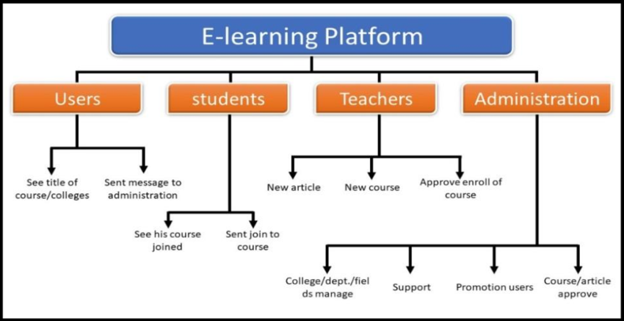
Block Diagram

Slide 10
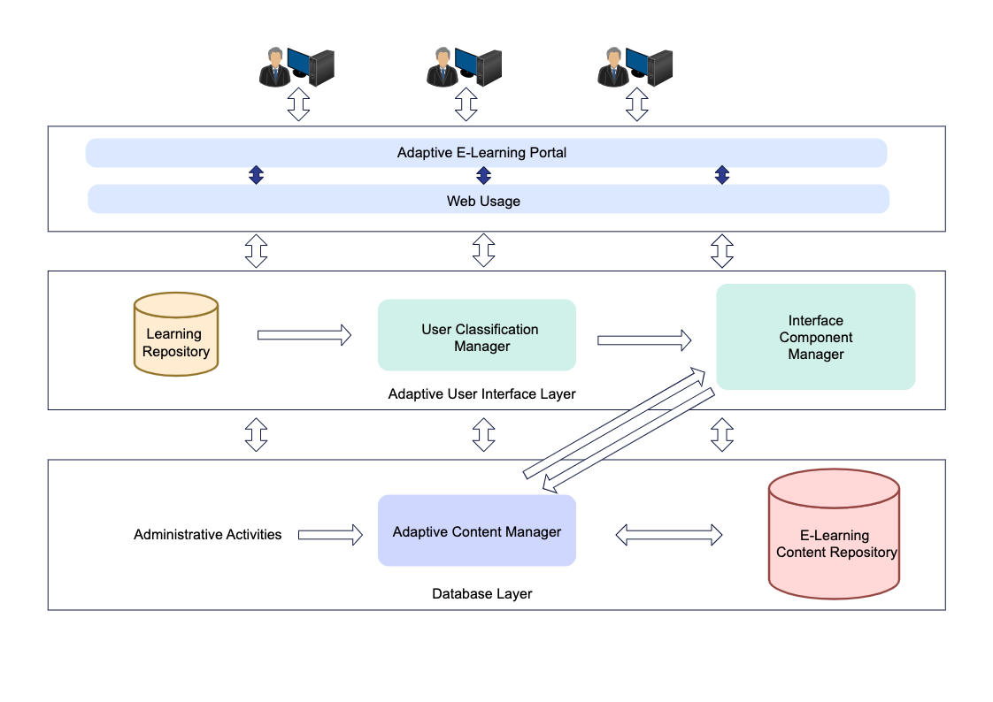
Architecture

Slide 11
Software Requirements
An e-learning platform requires both software and hardware systems to function effectively. Key considerations include a robust content management system (CMS) for course creation, secure authentication and data protection, scalability for growing user bases, and mobile app support for diverse learning environments. The key functional requirements for the LMS refer to the course creation, development, and delivery. They usually include user and course management, learning delivery, tracking and reporting, assessment tools, and features to support various learning strategies

Slide 12
Software Requirements
1. Backend:
Language: Python 3.8+
Framework: Django 3.x or 4.x
Web Server: Gunicorn or uWSGI
Operating System: Linux (Ubuntu preferred), Windows, or macOS
2. Frontend:
HTML5, CSS3, JavaScript
3. Development Tools:
Code Editor: VS Code / PyCharm
Version Control: Git + GitHub/GitLab/Bitbucket

Slide 13
Hardware Requirements
Processor: A post-2000 processor (e.g., Pentium IV or Celeron II) is generally sufficient.
RAM: At least 512 MB of RAM, but more is recommended for a smoother experience.
Hard Drive: A sufficient hard drive space to store course materials and user data.
Video Card: A video card with 128MB or more of video memory for displaying multimedia content.
Sound Card: A 16-bit sound card for audio-related content.
Internet Connection: A high-speed internet connection is essential for accessing the platform and downloading course materials.
Browser Compatibility: Support for popular browsers like Chrome, Firefox, and Edge, and potentially Internet Explorer (versions 9 or later).
Screen Resolution: A minimum screen resolution of 1024x768 is recommended.

Slide 14
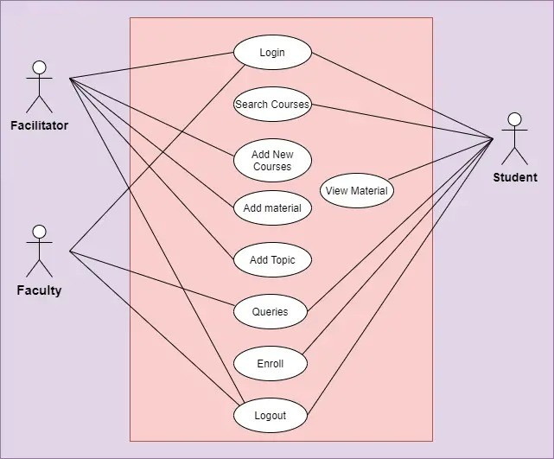
UML Diagrams

Slide 15
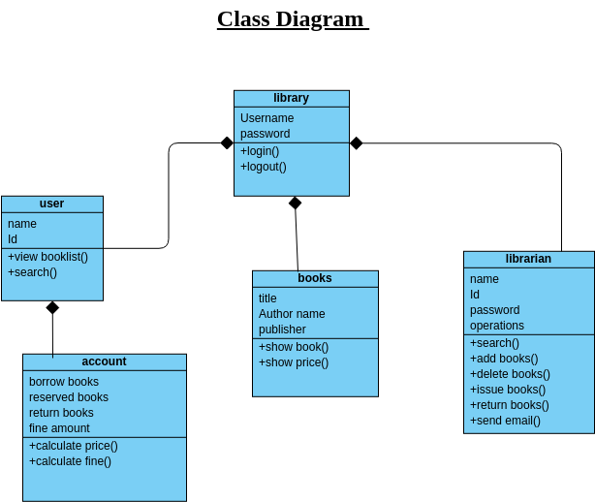
Use Diagrams
A class diagram for an e-learning platform would depict the key classes and their relationships within the system. These classes would include users (students, instructors, administrators), courses, modules, assessments, and potentially other features like forums or discussion boards. The diagram would illustrate how these classes interact and what attributes and operations they possess.

Slide 16
Roles Of Django and Python
In the development of an E-learning Platform, Django and Python play distinct yet complementary roles. Python, as the programming language, provides the foundation for writing the application's logic. Its clean syntax and extensive libraries make it ideal for rapid development and integration of features such as data processing, user interactions, and backend services. Django, a high-level web framework built on Python, streamlines web development by offering built-in tools for authentication, database management, URL routing, and template rendering. It handles much of the heavy lifting involved in creating a secure and scalable web application. While Python ensures flexibility and simplicity in writing the application logic, Django structures the development process and enforces best practices, allowing developers to focus on building a robust and interactive educational experience. Together, Python and Django enable the creation of a seamless, feature-rich platform for both educators and students.

Slide 17
Why Django & Python for E-Learning?
Django and Python form a powerful combination for developing a robust E-learning platform due to their inherent strengths. Python, as a versatile and readable language, offers rapid development capabilities and a vast ecosystem of libraries, making it ideal for handling complex backend logic, data processing, and integrations. Django, built on Python, provides a high-level, "batteries-included" web framework that accelerates development with its built-in features for user authentication, database management, and URL routing. This allows developers to focus on core E-learning functionalities like course management, interactive assignments, and real-time updates, rather than reinventing fundamental components.

Slide 18
Modules
User Management Module
Role-based access (Admin, Instructor, Student)
User authentication (login, logout, registration
2. Course Management Module
Create, update, delete courses
Course categorization (subjects, topics)
Enrollments and access control
3. Content Management Module
Upload and manage learning materials (PDFs, videos, slides)
Multimedia support (audio, video, images)

Slide 19
User Authentication Models
This refer to the strategies and systems used to verify the identity of users before granting them access to applications or services. These models ensure that users are who they claim to be, thereby safeguarding sensitive information, maintaining data integrity, and providing a personalized experience
This is the most widely used and straightforward model. Users register with a username and a password, which are stored (usually in a hashed format) in the system's database.
After a successful login, the server issues a token (typically JWT – JSON Web Token) that the client stores and sends with each request. During

Slide 20
Key Features & Functionality
Key Features & Functionality
Interactive Learning Support: The platform is designed to support interactive learning experiences.
Course Creation and Management: Educators can create and manage courses.
Learning Material Upload: Teachers can upload various learning materials for students.
Interactive Assignments and Quizzes: The platform allows for the design of interactive assignments and quizzes.
Course Content Access: Students can access course content easily.
Discussion Participation: Students can participate in discussions related to their courses.
Progress Tracking (Student-side): Students can track their own progress through a user-friendly interface.

Slide 21
Student Experience
Access to Course Content: Students can easily access course materials.
Participation in Discussions: The platform facilitates student engagement through discussions.
Progress Tracking: Students can track their academic progress, providing visibility into their learning journey.
User-Friendly Interface: The platform is designed with a user-friendly interface, making navigation and interaction intuitive.
Interactive Assignments and Quizzes: Students can engage with interactive assignments and quizzes designed by educators.

Slide 22
Benefits for Students
The E-learning Platform offers numerous advantages for students, significantly enhancing their learning journey. Firstly, it provides flexible access to education, allowing students to access course content, lectures, and assignments anytime, anywhere, at their own pace. This flexibility is particularly beneficial for those balancing studies with other commitments. Secondly, the platform fosters interactive and engaging learning through features like multimedia support, discussion forums, and interactive quizzes, moving beyond traditional passive learning. Students can actively participate in discussions, collaborate with peers, and receive immediate feedback on their progress. Lastly, the platform promotes personalized learning paths by enabling students to track their progress, identify areas for improvement, and receive tailored feedback from educators.

Slide 23
Benefits for Educators
E-learning Platform streamlines various aspects of course delivery and student management, making their role more efficient and impactful. Primarily, it offers robust course management tools, allowing educators to easily create, organize, and update course materials, upload diverse learning resources (documents, videos, presentations), and design comprehensive assignments and quizzes. This reduces administrative burden and frees up time for more focused teaching. Secondly, the platform facilitates enhanced student engagement and assessment through built-in communication tools, discussion boards, and automated grading features for quizzes. Educators can monitor student participation, provide timely feedback, and gain insights into overall class performance.

Slide 24
The Rise of Online Education
The landscape of education has undergone a significant transformation with the rapid rise of online education, driven by advancements in technology and a growing demand for flexible, accessible learning opportunities. Historically, traditional brick-and-mortar institutions were the primary mode of learning, but the advent of the internet and digital tools has democratized access to knowledge. This shift has been accelerated by global events, which highlighted the critical need for remote learning solutions. Online education platforms now offer diverse courses, from K-12 schooling to higher education degrees and professional development, catering to a wide demographic. This paradigm shift emphasizes self-paced learning, personalized content delivery, and interactive virtual environments, making education more inclusive and adaptable to individual needs and lifestyles.

Slide 25
Future of Online Education
The future of online education is poised for even greater innovation and integration into the global learning ecosystem. We can anticipate further advancements in personalized learning, driven by artificial intelligence and machine learning, which will adapt content and teaching methods to individual student needs and learning styles. Virtual and augmented reality are expected to create more immersive and interactive learning environments, offering hands-on experiences that transcend geographical boundaries. Furthermore, the emphasis on micro-credentials, skill-based learning, and lifelong education will likely grow, making online platforms crucial for continuous professional development and career transitions.

Slide 26
Conclusion
e-learning platforms are not just a tool for distance education; they are a catalyst for transformative change in the way we learn and teach. By embracing technology and leveraging its power, we can create more effective, engaging, and accessible learning experiences for all. The future of education is undoubtedly shaped by the advancements in e-learning, and we must continue to innovate and adapt to ensure that learning remains a lifelong, empowering journey for everyone.

Slide 27
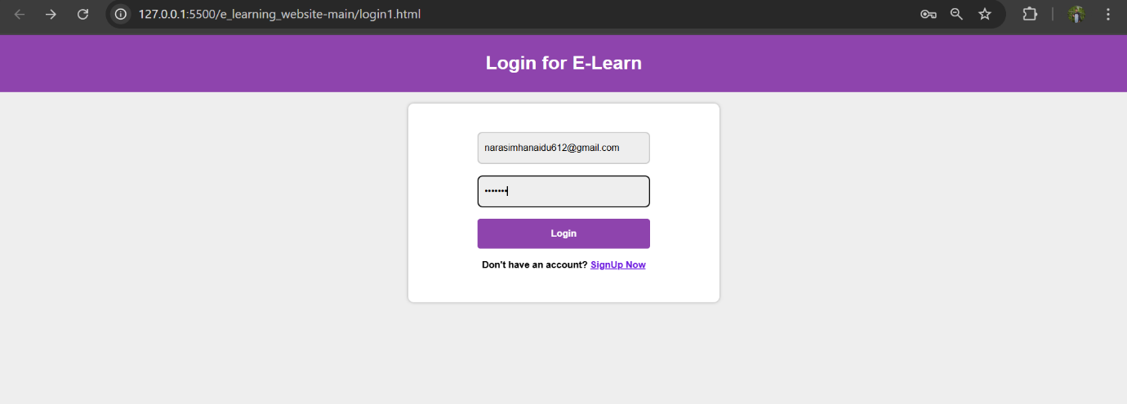
Output Screens
Step 1:login page

Slide 28
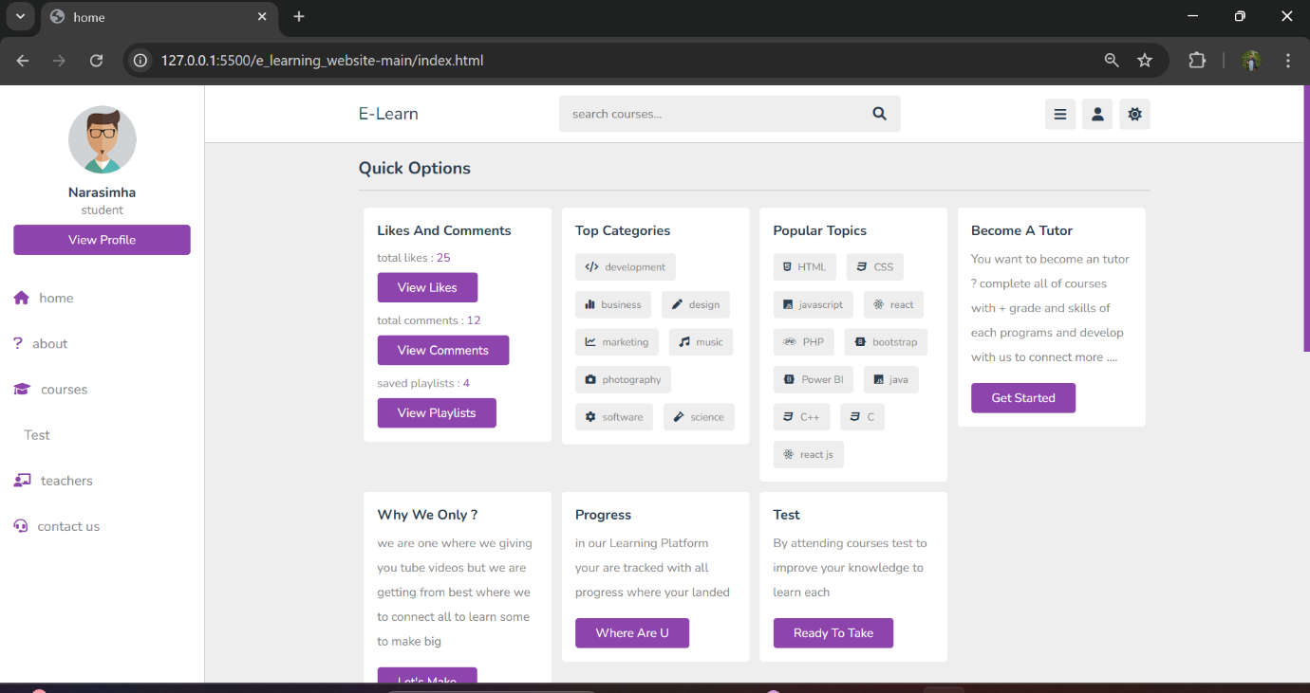
Step 2 Home Screen of e learning website

Slide 29
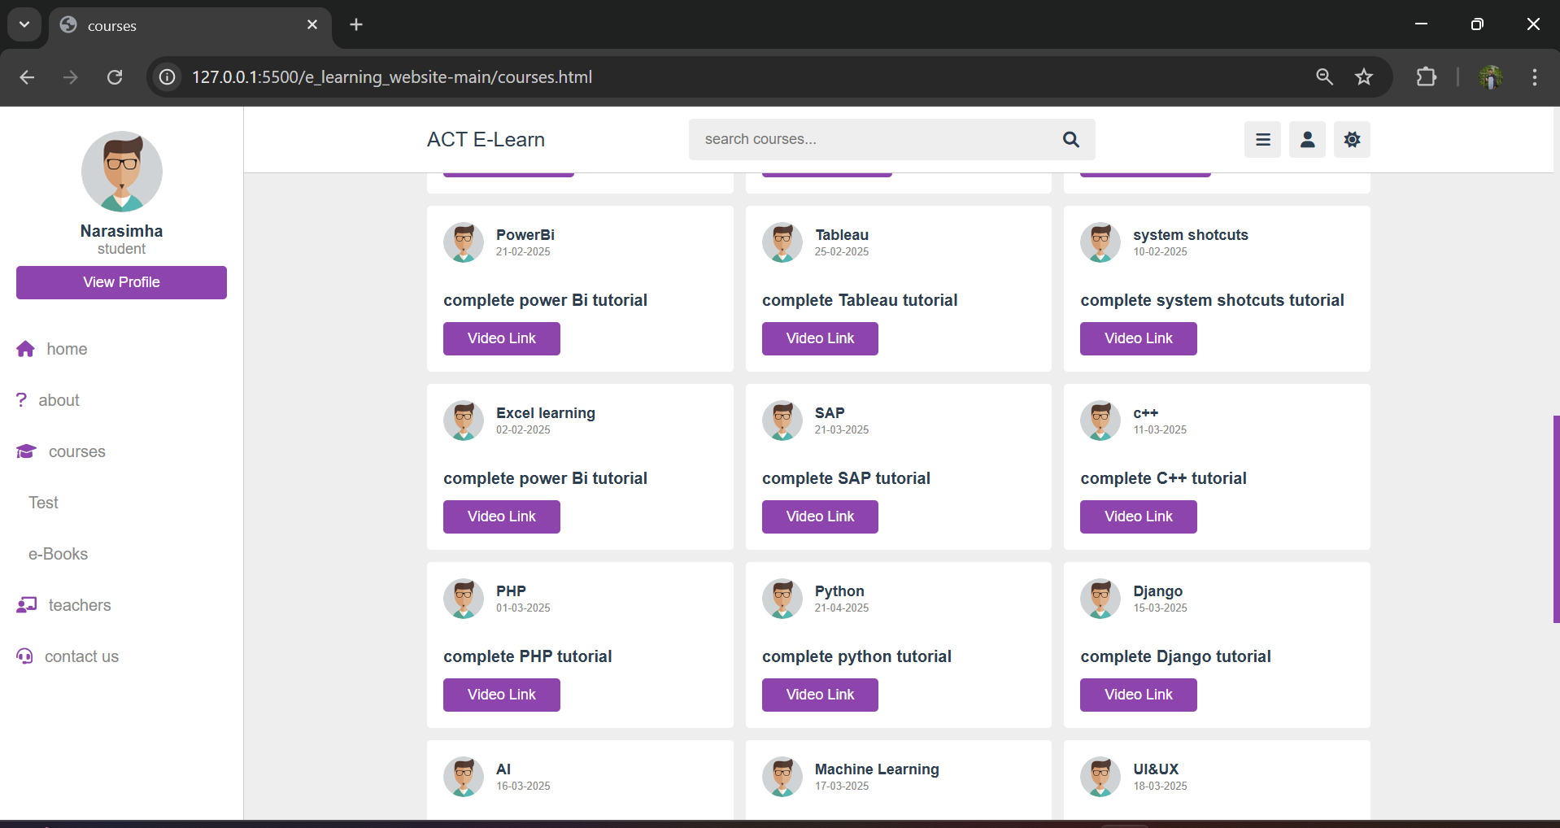
Step 3: courses page

Slide 30
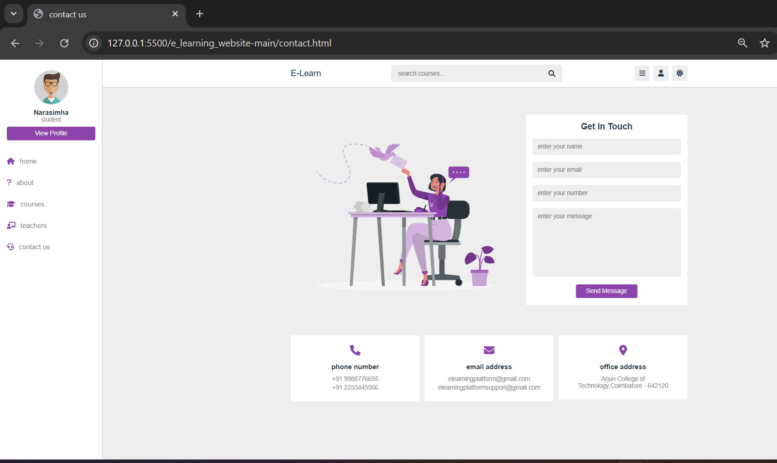
Step :4 contact details

Slide 31

Thank You

